Slide 1

Slicing Aided Hyper Inference (SAHI) for Small Object Detection | Explained
29/06/2023

Slide 2
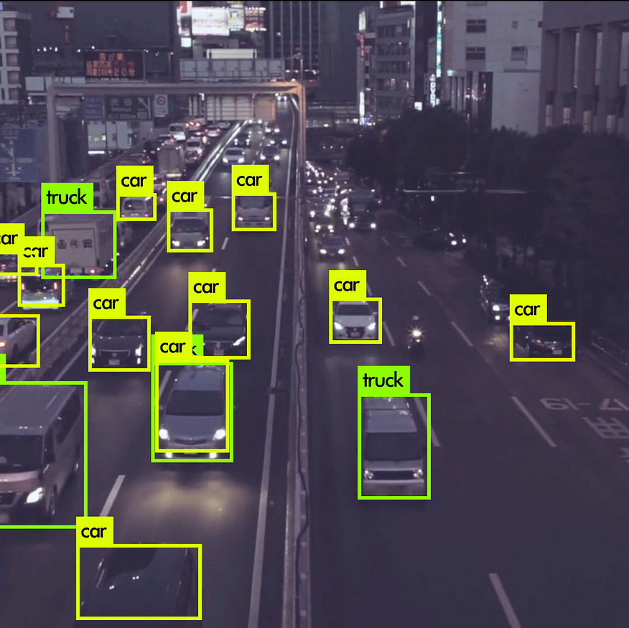
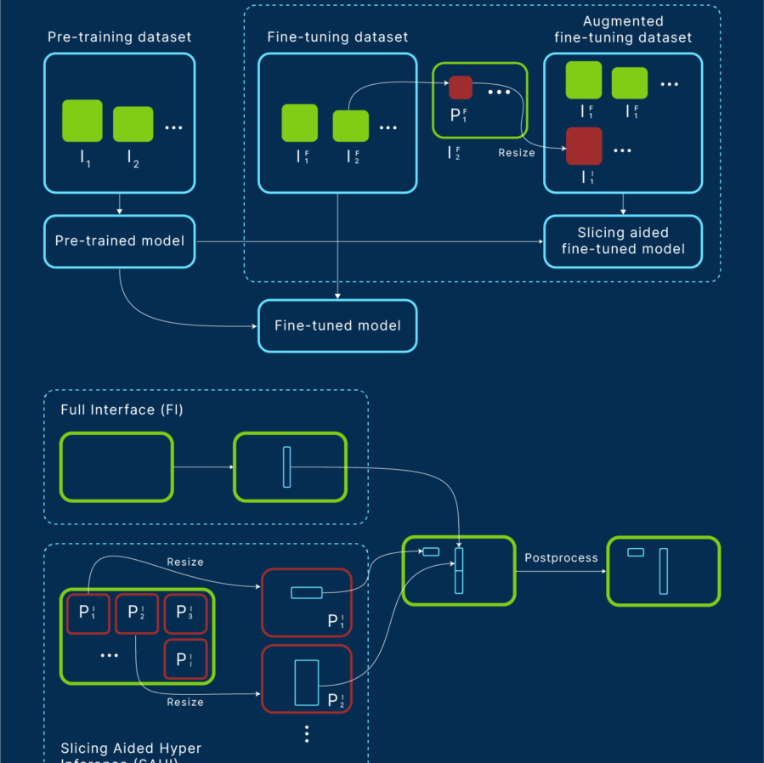
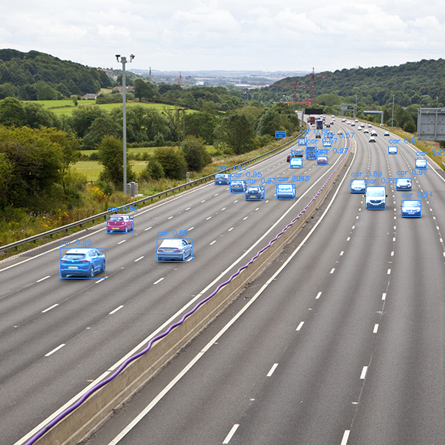
Agenda
I. Small Object Detection:
1. Applications
2. Limitations of Traditional Object Detectors
3. Existing Approaches
II. Slicing Aided Hyper Inference (SAHI)
1.What is SAHI ?
2. Slicing Aided Fine Tuning
3. Slicing Aided Hyper Inference
III. Summary and Key Takeaways

Slide 3
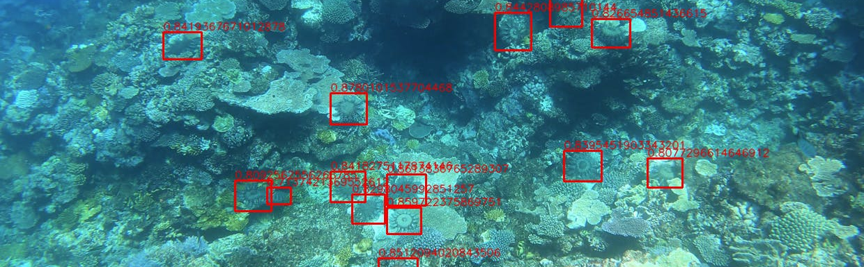
Introduction
Small object detection is a subfield of computer vision and object detection that focuses on the task of detecting and localizing objects that are relatively small in size in an image or video.
Slicing Aided Hyper Inference (SAHI) is an open-source framework that was designed to address this issue.

Slide 4
Introduction
Before we dive into the details of Slicing Aided Hyper Inference (SAHI), let’s discuss object detection models and small object detection.

Slide 5

Small Object Detection
1. Applications of Small Object Detection

Slide 6
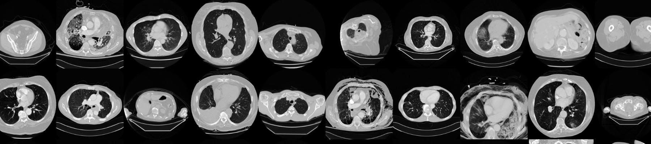
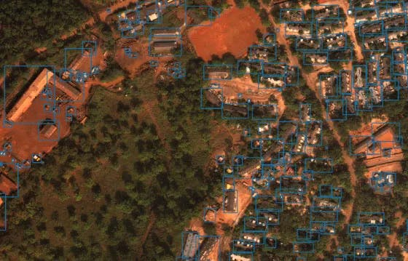
Surveillance and Security
Autonomous Driving
Robotics
Medical Imaging
Wildlife Conservation
Retail and Inventory Management
Quality Control and Manufacturing
Aerial and Satellite Imagery

Slide 7
Small Object Detection
2. Limitations of Traditional Object Detectors in Small Object Detection

Slide 8
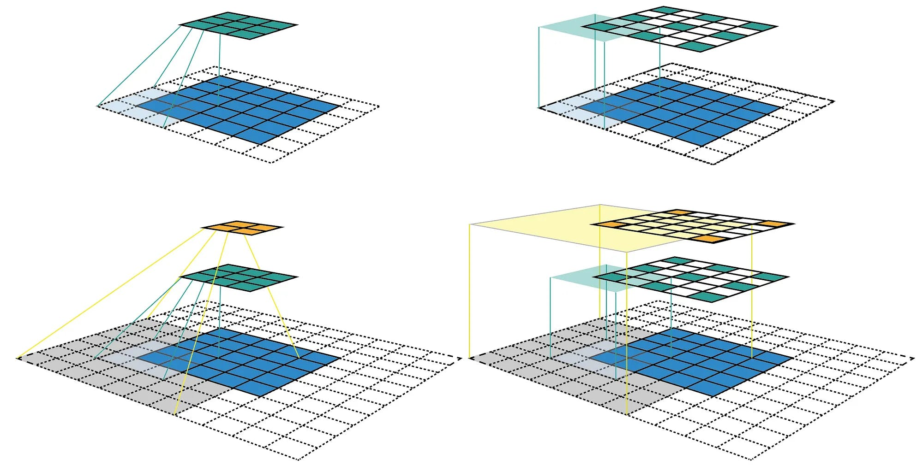
Limited Receptive Field:
The receptive field of a neuron or filter in a convolutional neural network (CNN) refers to the area of the input image that impacts its output.
In traditional object detectors, the receptive field may be restricted, especially in the initial layers.
As a result, there is insufficient contextual information for small objects, hindering the network's detection accuracy.

Slide 9
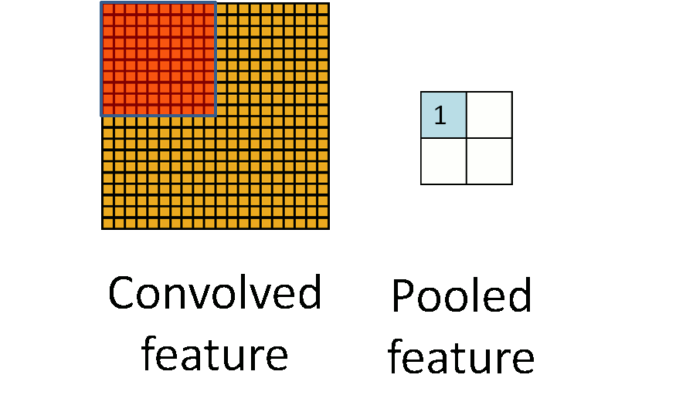
Feature Representation
Object detectors rely on learned features within CNN architectures to recognize objects.
However, the limitations of feature representation may hinder the detection of smaller objects.
Learned features may not adequately capture the subtle and intricate details of smaller objects.
Consequently, the detector may fail to differentiate smaller objects from the background or similar-looking objects.
Feature Representation in Convolutional Neural Network

Slide 10
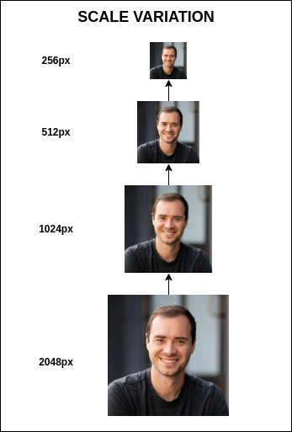
Scale Variation
Small objects show significant scale variations compared to larger objects within an image.
Object detectors trained on datasets primarily composed of larger objects, like ImageNet or COCO, may struggle to generalize to small objects due to scale discrepancies.
Variations in object size can make it challenging to match learned object representations, leading to decreased detection performance for smaller objects.

Slide 11
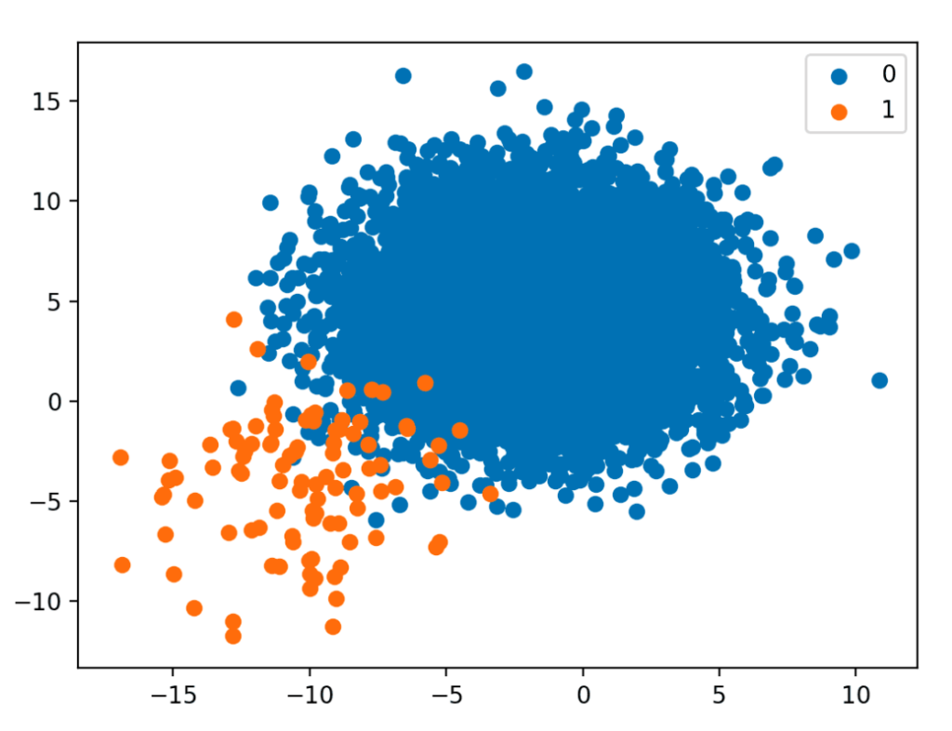
Class Imbalance
Object detection models trained on imbalanced datasets may exhibit a bias towards larger objects.
Imbalanced datasets have significantly fewer occurrences of small objects compared to larger objects.
This bias can cause the models to prioritize and emphasize detecting larger objects over smaller ones.
As a result, the detection performance of small objects can be diminished.

Slide 12
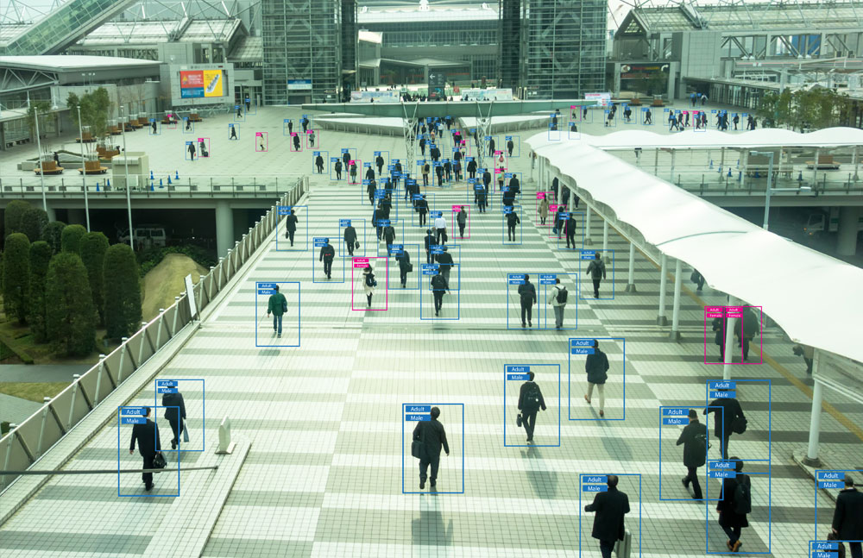
Localization Challenges
Localizing smaller objects accurately can be challenging due to the limited spatial resolution of feature maps in CNN architectures.
The lower resolutions may result in the loss or indistinguishability of fine-grained details required for precise localization of small objects.
Occlusion by larger objects or cluttered backgrounds adds to the difficulty of accurately localizing small objects.

Slide 13
Small Object Detection
3. Existing Approaches for Small Object Detection

Slide 14
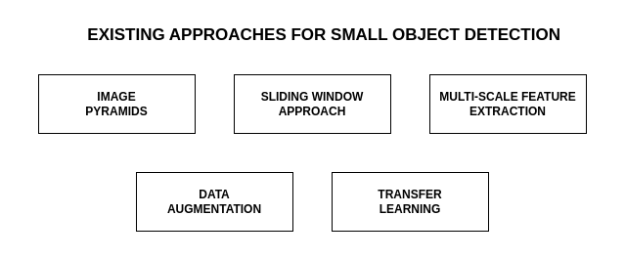

Slide 15
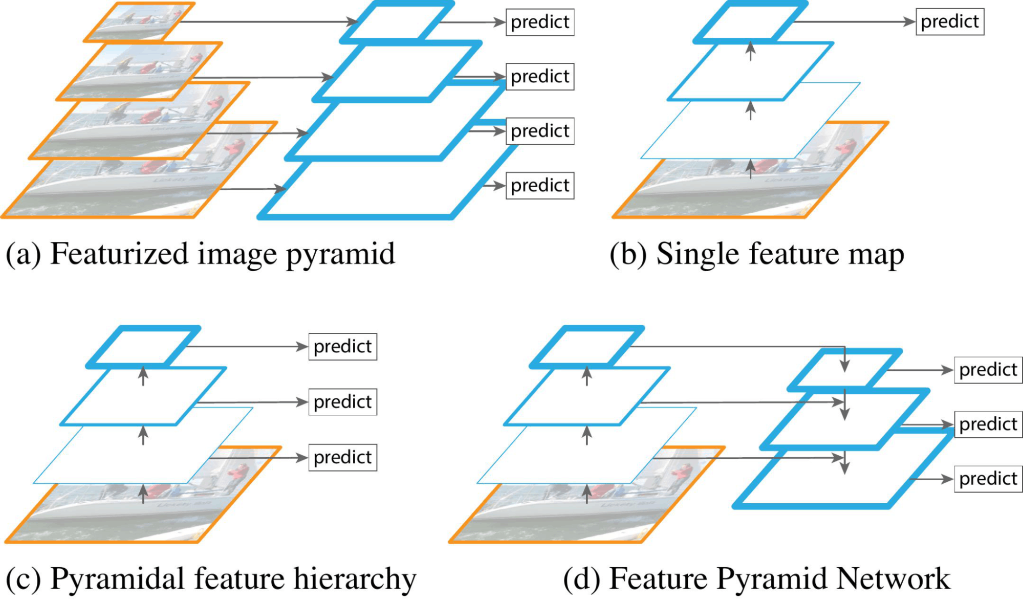
Feature Pyramid Networks (FPN)
FPNs (Feature Pyramid Networks) aim to capture multi-scale information by constructing feature pyramids with different resolutions.
The FPN architecture comprises a bottom-up pathway that captures features at various resolutions and a top-down pathway that fuses and up samples the feature maps, creating a pyramid structure.
The network aggregates context from coarser levels and preserves fine-grained information from lower resolutions.
FPNs enhance the understanding of small object characteristics by combining context and detailed information, improving the detection and localization of small objects.

Slide 16
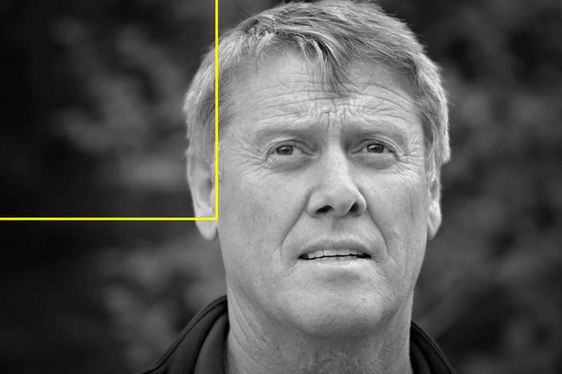
Sliding Window
The sliding window approach is commonly used for object detection, including small object detection.
It involves systematically moving a fixed window across the image at different locations and scales.
A classifier or similarity measure is used to evaluate the window at each position to determine object presence.
For small object detection, smaller window sizes and strides can be used to capture finer details.
Considering multiple scales and positions is necessary to increase the chances of accurate detection.
is computationally expensive

Slide 17
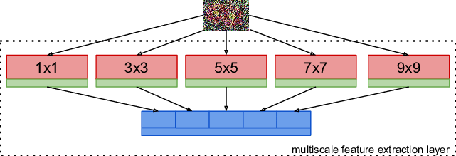
Single Shot MultiBox Detector (SSD)
SSD performs real-time object detection by directly predicting object bounding boxes and class probabilities from convolutional feature maps.
In SSD, feature maps from different layers with varying receptive fields are used to detect objects at multiple scales.
The multi-scale approach in SSD enables effective detection of small object sizes present in the image.
By utilizing feature maps from multiple layers, SSD captures fine-grained details in earlier layers and leverages high-level semantic information from deeper layers.

Slide 18
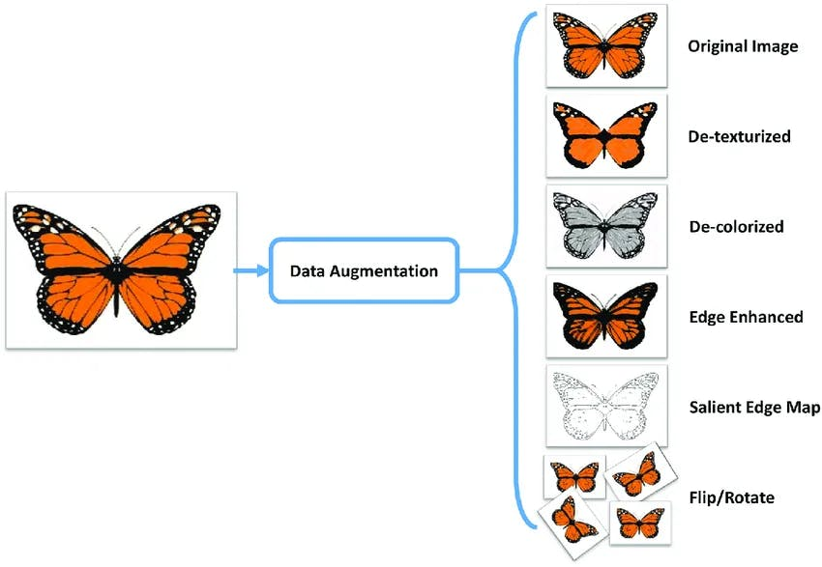
Data Augmentation
It involves augmenting the data by applying various transformations such as random scaling, flipping, rotation, and cropping.
These transformations introduce variations in the appearance, scale, and context of small objects in the training data.
Data augmentation helps the network generalize better and improves its robustness to different object sizes and orientations during inference.

Slide 19
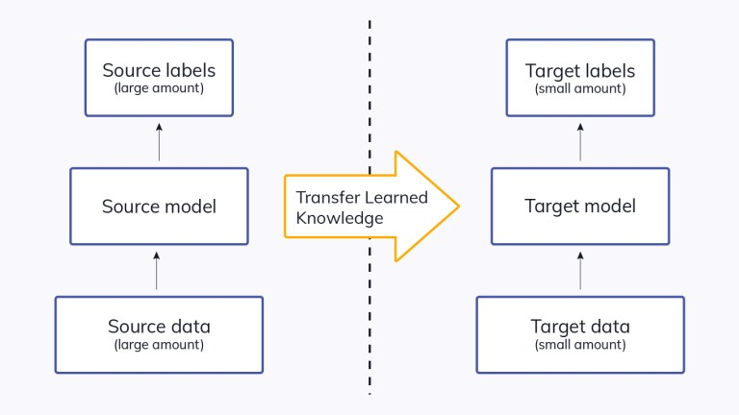
Transfer Learning
It involves adapting pre-trained models, trained on large-scale datasets, for detecting small objects.
The pre-trained models are fine-tuned on task-specific datasets to leverage their learned visual features and representations.
Transfer learning helps in better understanding and detection of small objects.
It addresses the limited data problem and reduces computational requirements by utilizing pre-existing knowledge.

Slide 20
Slicing Aided Hyper Inference (SAHI)
1. What is SAHI, Slicing Aided Hyper Inference?

Slide 21
Slicing Aided Hyper Inference (SAHI)
SAHI is an innovative pipeline tailored for small object detection, leveraging slicing aided inference and fine-tuning techniques to revolutionize the detection process.
By dividing the input images into overlapping patches, SAHI ensures that small objects have relatively larger pixel areas, enhancing their visibility within the network.

Slide 22
Slicing Aided Hyper Inference (SAHI)
2. Slicing Aided Fine Tuning

Slide 23
Fine Tuning vs Transfer Learning
Fine-tuning and transfer learning are techniques used in machine learning with pre-trained models.
Transfer learning applies knowledge from one task to a related task by starting with a pre-trained model.
In transfer learning, only the final layers of the pre-trained model are trained on the new task.
Transfer learning is beneficial when the new task has limited labeled data.
Fine-tuning allows the model to adapt its learned representations to a new task.
Fine-tuning is used when the new task has a larger dataset and requires learning task-specific features.
Fine-tuning modifies a pre-trained model by unfreezing some or all of its layers.
The choice between transfer learning and fine-tuning depends on factors such as dataset size and task similarity.

Slide 24
Why Slicing Aided Fine Tuning ?
Popular object detection frameworks like Detectron2 , MMDetection, and YOLOv8 provide pre-trained weights on widely-used datasets such as ImageNet and MS COCO.
However, the datasets commonly used for pretraining consist of low-resolution images with relatively large objects covering a significant portion of the image height.
As a result, pre-trained models perform well for similar inputs but struggle with small object detection in high-resolution images captured by advanced drones and surveillance cameras.
To overcome this limitation, an approach is proposed to augment the dataset by extracting patches from the fine-tuning dataset images

Slide 25
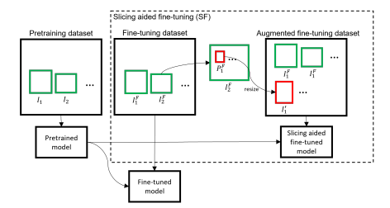
Concept of Slicing Aided Fine Tuning
Each image is sliced into overlapping patches with dimensions M and N.
The dimensions M and N are selected from predefined ranges [Mmin, Mmax] and [Nmin, Nmax] as hyperparameters.
During fine-tuning, these patches are resized while maintaining the aspect ratio.
The resized patches create augmentation images that aim to increase the relative size of objects compared to the original image.
The original images are also utilized during the fine-tuning process.
This utilization of original images helps in detecting large objects effectively.

Slide 26
Slicing Aided Hyper Inference (SAHI)
3. Slicing Aided Hyper Inference

Slide 27
A step-by-step breakdown of the process:
The original query image is divided into smaller overlapping patches, which are essentially smaller sections of the image. These patches have dimensions M × N, indicating their width and height.
Each patch is then resized while maintaining the aspect ratio. Resizing is done to ensure that the patches are of a consistent size and can be processed efficiently.
An independent object detection operation is performed on each of the overlapping patches. This means that object detection is applied separately to each patch.
In addition to the patch-wise detection, there is an optional step where a full-inference is performed using the original image. This step is used to detect larger objects that may span across multiple patches.

Slide 28
A step-by-step breakdown of the process:
5. The results obtained from the object detection process on the overlapping patches, along with the results from the full-inference step (if performed), are then merged back to the original image size. This merging process is done using a technique called Non-Maximum Suppression (NMS).
6. During the NMS process, boxes or bounding boxes that represent detected objects with Intersection over Union (IoU) ratios higher than a predefined matching threshold are considered matches. IoU is a measure of how much two bounding boxes overlap. The matching threshold is used to determine how much overlap is required for two boxes to be considered as matching detections.
7. For each match, the results with detection probabilities lower than a certain threshold are discarded. This step ensures that only the most confident and non-overlapping detections are retained. In other words, detections with low probability or those that overlap significantly with other detections are removed.
IoU = Area of Intersection / Area of Union
The IoU value ranges between 0 and 1, with 0 indicating no overlap and 1 indicating a perfect match between the predicted and ground truth regions.

Slide 29
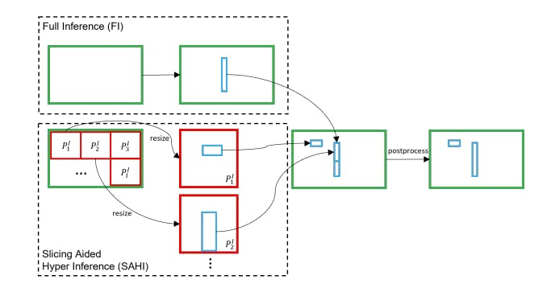

Slide 30
Summary and Key Takeaways

Slide 31
SAHI (Slicing Aided Hyper Inference) is a cutting-edge framework designed for small object detection, addressing the challenges posed by limited receptive fields, spatial resolution, contextual information, and class imbalance in traditional object detectors.
SAHI utilizes slicing-aided fine-tuning to balance the representation of small objects in pre-training datasets, enabling models to better detect and localize small objects in high-resolution images.
Slicing-aided fine-tuning augments the dataset by extracting patches from the images and resizing them to a larger size.
During slicing aided hyper inference, the image is divided into smaller patches, and predictions are generated from larger resized versions of these patches and then converted back into the original image coordinated after NMS.
SAHI can directly be integrated into any object detection inference pipeline and does not require pre-training.

